Slide 1
Goin’ Fishin’
on the Azure Data Lake

Slide 2
About Me
Graduated from Tennessee Tech in December 2011
Computer Science
Nashville Native
Working with SQL Server since 2010
Data Warehousing/Business Intelligence
Application Development
Twitter: @SpencerSwindell
Email: spencer.swindell@gmail.com
Blog: mytwospence.com

Slide 3

Think Data Insights
Modern Data Warehouse Design and Architecture
On-Premise SQL Server and Azure Data Platform
PowerBI Solutions and Training
Advanced Analytics and Machine Learning
Based in Nashville, TN
Microsoft Gold Partner

Slide 4
LBMC
MAKE A GOOD BUSINESS BETTER

Slide 5
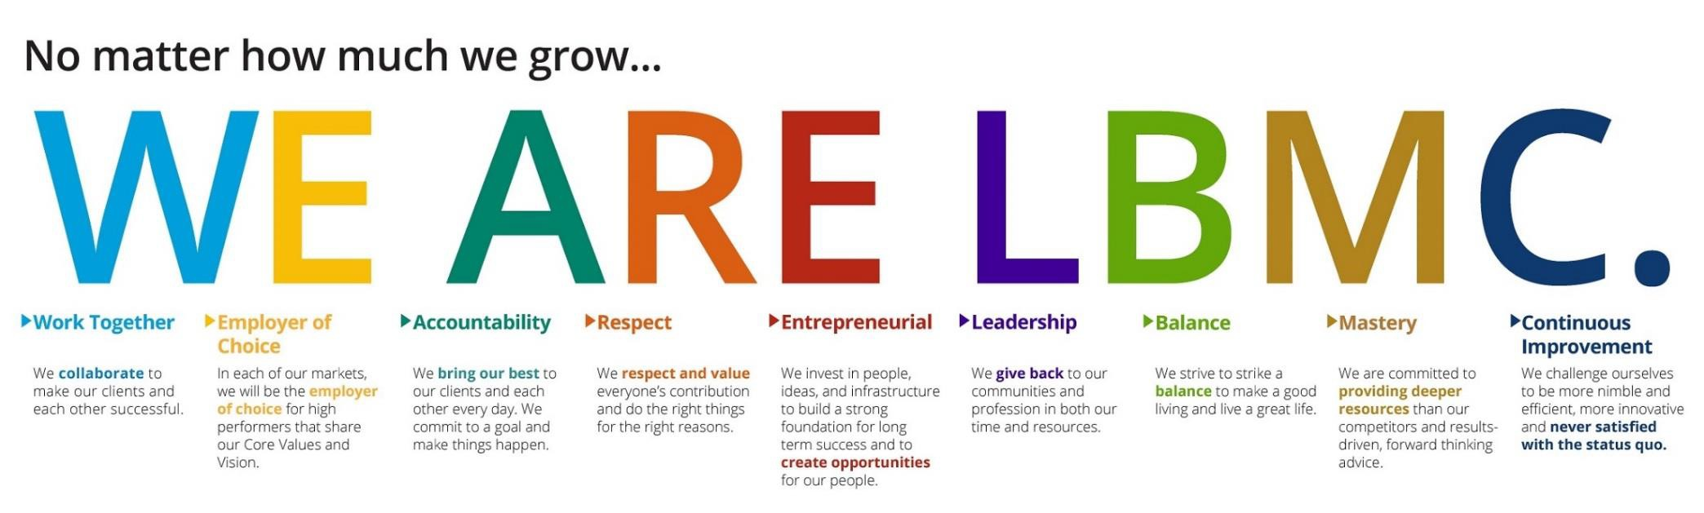
Our Values
Our core purpose is to make a
good business better.
Our shared vision is to make LBMC
the best choice for clients and colleagues.

Slide 6








Assurance
Transaction Services
Tax
Litigation Valuation
LBMC, PC
Healthcare Consulting
Information Security
State and Local Tax
Family Office

Slide 7





LBMC Technology Solutions, LLC
LBMC Employment Partners, LLC
LBMC Information Security, LLC
LBMC Staffing Solutions, LLC
Financial Services, LLC
LBMC Info Sec App, LLC
LBMC Physician Business Solutions , LLC
LBMC Investment Advisors, LLC
LBMC
W Squared, LLC
LBMC Procurement, LLC

Slide 8




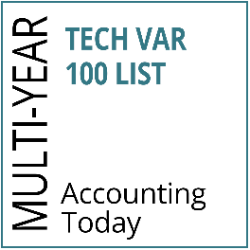


LBMC Technology Solutions LLC
BUSINESS & SOFTWARE
CONSULTING
Financial Software
(Intacct, Microsoft Dynamics 365, GP and SL)
Customer Relationship Management (CRM) software
(Microsoft Dynamics CRM, Salesforce) Enterprise Content Management
Software
(OnBase, Square 9, Box)
Office Automation Software (Office 365)
CLOUD COMPUTING & MANAGED SERVICES
On-Premise and Cloud Infrastructure Setup and Support (Amazon and Microsoft)
Remote Managed Services and Backup Solutions (TechCare)
Infrastructure as a Service Phone Systems (Digium)
Security Solutions
Outsourced CIO-level Services
SOFTWARE DEVELOPMENT
& BUSINESS INTELLIGENCE
Customized Software Development to include Mobile and Web Development
Business Intelligence (Power BI) & Data Warehousing
Microsoft SharePoint Services
Custom Integrations between line of Business Applications
Implementation and Support of Microsoft SQL Server and SQL Reporting Services
◆
◆
◆
◆
◆
◆
◆
◆
◆
◆
◆
◆
◆
◆
◆

Slide 9









LBMC Employment Partners LLC
THE LBMC DIFFERENCE
SERVICES
TRUSTED PARTNER
◆
Dedicated Human Resources Account Manager
Experienced and Knowledgeable Staff Strong Partnerships with BCBST and
Lincoln Financial Group
Partnership with Healthcare 21 Business Coalition (HC21)
Benefit Advocacy Services Health & Wellness Initiatives
Partnership with Zurich for Workers’
Compensation Insurance
Market Leader in the Professional
Service Industry
Recognized as a Member of the National Association of Professional Employer Organizations (NAPEO)
Innovative and Efficient User of Progressive Technology
◆
Certified Professional Employer Organization (CPEO)
Human Resources Outsourcing (HRO) Payroll Tax Outsourcing and Consulting Employee Benefits
Payroll Services
Human Resource Consulting
ACA Compliance Consulting and Tracking Services
◆
Our employees keep us on the road, and that makes them our greatest asset. We made a great business decision when we decided to hire LBMC Employment Partners to help us take care of those who take care of our customers.”
◆
◆
◆
◆
◆
◆
◆
◆
◆
◆
◆
– President & CEO, Distribution Service Company
◆
◆
◆
First CPEO certified provider in Tennessee

Slide 10



LBMC Staffing Solutions LLC
THE LBMC DIFFERENCE
CONTRACT PLACEMENT AND DIRECT HIRE POSITIONS
TRUSTED PARTNER
◆
Professional Recruiters with Expertise in
the Specific Disciplines for Which They Recruit
Expansive Candidate Referral Network through Affiliation with One of the Southeast’s Premier Financial Services Firms
Enhanced Employee Retention with Pre- Screened Candidates for Technical and Cultural Fit
Consultative Approach Supported by Market Knowledge and Industry Experience
Efficient Qualification, Selection and Presentation of Candidates
Accounting & Finance
Human Resources
Information Technology
Executive Administration
Key Specialized Manufacturing Roles
◆
◆
They are committed to excellence, and finding a “perfect fit” for our position that will be with us for years to come. The strong skills the LBMC team brings to the table make them outstanding at partnering with us to select individuals at all levels to join our team.”
–PHR Director of Human Resources, Healthcare Management Solutions Provider
◆
◆
◆
◆
◆
◆
◆

Slide 11





LBMC Investment Advisors LLC
INVESTMENT & ADVISORY SERVICES
Customized Investment Portfolios
Index ETFs and Individual Bonds
LBMC IA App
Coordinated Tax and Investment Advice

Slide 12




LBMC Information Security LLC
MANAGED SECURITY SERVICES
LBMC will minimize threats and respond with:
◆
Intrusion Prevention and Detection Services Security Information and Event Management Incident Response and Forensics Vulnerability and Threat Management
◆
◆
◆

Slide 13


LBMC W Squared LLC
Outsourced Finance
Outsourced Services
Our people, our processes and our infrastructure are ready to scale with you.
Strategic & Financial Management Services
CFO-level expertise & strategy
Comprehensive financial analysis (budgeting, forecasting & pro forma)
Preparation & process for future monetization event
Relationship management with private equity/venture capital partners
Investor pitch development
Capital funding strategy
Accounting Services
Comprehensive financial statement reporting (Analysis, KPIs, Board Package)
Month-end close & general ledger management
Accounts payable/receivable processing
Cash management
Electronic payments capability
Multi-entity consolidation & segment reporting
Tax & audit package preparation

Slide 14
LBMC Procurement Solutions LLC
PROCUREMENT SERVICES
Purchase like an enterprise.
Aggregating at SKU Level
Deeply Rooted Supply Base Relationships
Quarterly Business Review (QBR) Process for Suppliers
Client Partner Reporting
Negotiated Pricing with Extensive Supplier Network
Medical and Surgical Supplies and Equipment
National Lab Testing
Office Supplies
Lab Consumables
Small Package Shipping
Travel
Printed and Promotional Products
IT Software/Hardware
Office Renovations

Slide 15




LBMC Physician Business Solutions LLC
PHYSICIAN PRACTICE REVENUE CYCLE SOLUTIONS
PHYSICIAN MANAGEMENT SUPPORT & EMR SOLUTIONS
PHYSICIAN PRACTICE MANAGEMENT/ ADMINISTRATIVE OVERSIGHT
MEDICAL SERVICES ORGANIZATION (MSO)
Expert financial management
Everything you need to conquer billing, collections, claims processing
Efficient, cost-effective oversight with an eye to your bottom line
Comprehensive solution tailored to specific physician- related needs
◆ IT Solution Featuring Electronic Medical Records
◆ Revenue Cycle Staffing
◆ Claims Processing
◆ Accounts Receivable Management
◆ Patient Billing
◆ Payment Processing
◆ Monthly A/R Closeout Reporting
◆ Certified Coding Oversight
Electronic Medical Records
(EMR) Vendor Review
EMR Selection, Implementation and Management
IT Solutions
PMR-EMR-HER
Selection of PM/EMR Solution
Request for Proposal Development
Vendor Evaluation
Contract Negotiation
Implementation of PM/EMR, including:
Management Support
Regular Onsite Visits
Workflow Processes Management
Software Interface Management
Data Migration Supervision
Template Creation
Go LIVE Support
Administrative Oversight- Administrative Consulting Services to Support Practice Leaders
Financial and Operational Consulting
Human Resources Services
Coding, Billing, Corporate Compliance including ICD-10 Implementation and Training
MACRA/MIPS
Physician Practice Billing/Collection Services
Benefits and Human Resources Services (HRO/PEO)
Physician Practice Management and Administrative Oversight
Coding/Compliance Services
Practice Management Consulting, as needed
Outsourced Accounting
GPO

Slide 16

BALLAST
BALLAST
Automating and Empowering Risk Management
Reducing Assessment Fatigue
Software as a Service
Subscription-based
Automated Assessments for:
Cyber Risk
Compliance
Vendor Risk
Operational Controls
Client Defined/Custom
Dashboard Reporting
Remediation Management and Tracking
Repository for Assessment Evidence
Versions available for
End-user organizations
3rd Party Assessors & Consultants

Slide 17
Agenda
Azure Data Lake
Use case – Storage for Modern Data Warehouse
Distributed Filesystem
Azure Data Lake V2
Working w/ Azure Data Lake
Azure Data Factory
Azure Data Bricks
Azure SQL DW – Polybase
Pricing

Slide 18
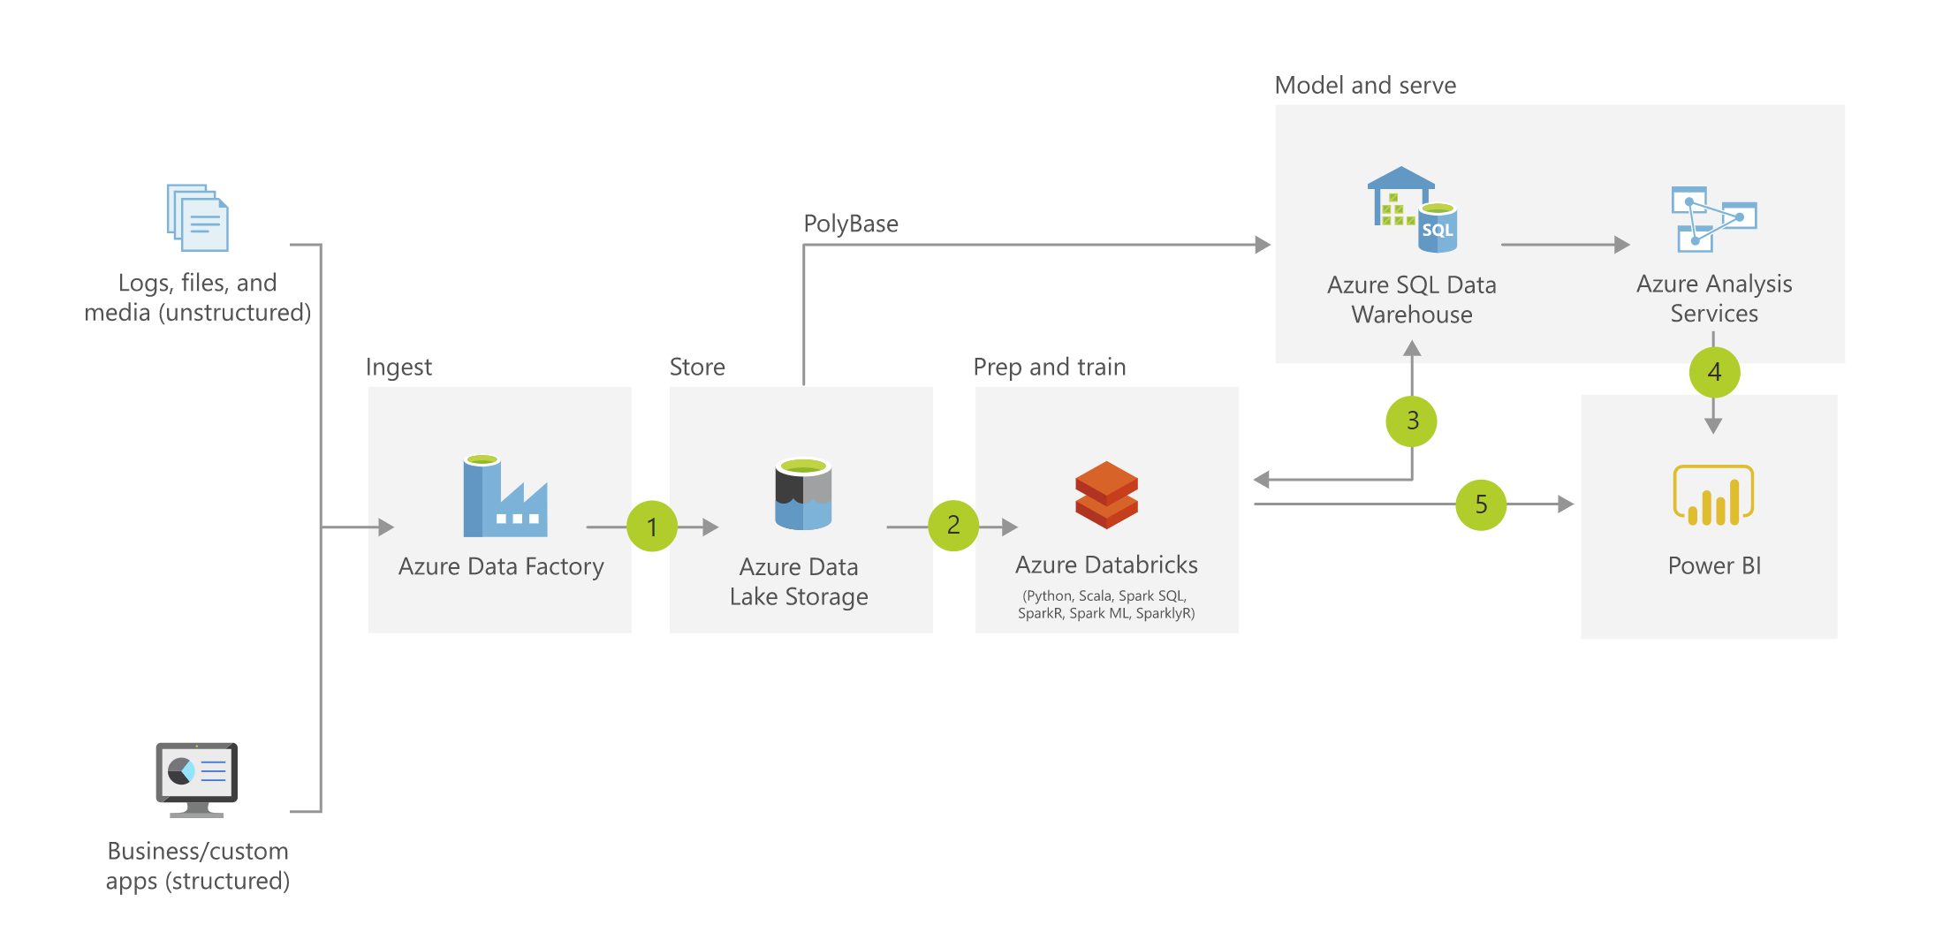
Modern Data Warehouse

Slide 19
Comparison w/ SQL Server

Slide 20
The Data Lake Idea
Distributed File System
HDFS compatible
Files are stored/replicated across a cluster of machines
Ensures data isn’t lost in the case of hardware failure
“Unlimited Storage” / Petabyte files
Data is stored in files
CSV, JSON, Arvo, Parquet, Plain Text

Slide 21
Distributed File Systems
MASTER
data.csv

Slide 22
Distributed File Systems
MASTER
1
2
3
4

Slide 23
Distributed File Systems
MASTER
1
2
3
4

Slide 24
Distributed File Systems
MASTER
1
2
3
2
1
4
3
1
4
4
3
2

Slide 25
Starting to make waves
Data accessed via adl endpoints
adl://tdilendingclubdemo.azuredatalakestore.net/Raw/Historical/LendingClubHistorical.parquet
Security
Integrated with Azure Active Directory
Supports OAuth 2.0 for authentication with the REST API
Encryption is on by default
Transparent (Encrypted on Write/Decrypted on Read)
Data In motion encrypted using HTTPS

Slide 26
In over my head…
Azure Data Factory
HDInsight
Azure Data Bricks
Azure SQL DW
Azure Analysis Services (Preview)
PowerBI (Preview)

Slide 27
Azure Data Factory
Orchestration tool for data movement and ETL
Platform as a Service (PaaS)
No need to worry about infrastructure
Effectively copy data to/from Azure Data Lake from a variety of sources
70+ connectors
Schedule Jobs to execute pipelines
Demo
Move data from “On-Premise” to Azure Data Lake

Slide 28
Data Lake Analytics
Platform as a Service (PaaS)
Scale instantly as needed
Pay for processing power used
U-SQL
Unified SQL
SQL with .NET
Works directly with Azure Data Lake

Slide 29
HDInsight
Hadoop in the cloud
Quick spin up big data clusters on demand
Work with entire Hadoop ecosystem
MapReduce
Hive
Pig
Spark
Kafka
Storm
HBase
… and the other 146 Pokémon

Slide 30
Azure Data Bricks
Spark based processing / analytics service
Support for Deep Learning frameworks and GPU based processing
On demand computing clusters
Auto-Scale and Auto-Terminate
Collaborate with Notebooks in Azure Data Bricks
Demo
Analyze data from Azure Data Lake Store

Slide 31
Azure SQL DW
MPP solution for SQL Server
Massively Parallel Processing
Polybase feature connects to Azure Data Lake
Quickly bring data into SQL DW to update a dimensional model
Demo
Extract data from Data Lake using Polybase

Slide 32
Polybase
Azure Data Lake
MASTER
Azure SQL DW
1
2
3
2
1
4
MASTER
DATA
DATA
DATA
DATA
3
1
4
4
3
2

Slide 33

Polybase
Azure Data Lake
MASTER
Azure SQL DW
1
2
3
2
1
4
MASTER
DATA
DATA
DATA
DATA
3
1
4
4
3
2

Slide 34

Polybase
Azure Data Lake
MASTER
Azure SQL DW
1
2
3
2
1
4
MASTER
DATA
DATA
DATA
DATA
3
1
4
4
3
2

Slide 35

Polybase
Azure Data Lake
MASTER
Azure SQL DW
1
2
3
2
1
4
MASTER
DATA
DATA
DATA
DATA
3
1
4
4
3
2

Slide 36

Polybase
Azure Data Lake
MASTER
Azure SQL DW
1
2
3
2
1
4
MASTER
DATA
DATA
DATA
DATA
3
1
4
4
3
2

Slide 37
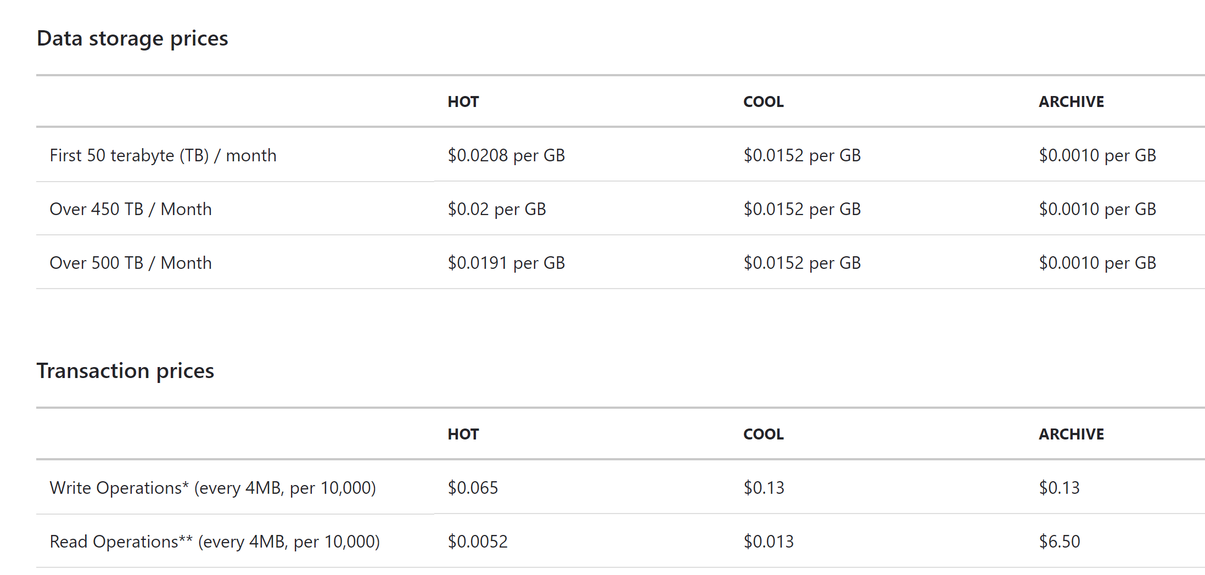
Pricing

Slide 38
Cast a wide net
ADL
1GB - $0.04
Read/Write - $0.05
ADF - $2
Azure Data Bricks - $0.95
Azure SQL DW - $6.04 (Not including storage @ $122.88 per TB)
Total - $9.08

Slide 39
What’s Next on the Horizon
Azure Data Lake v2
Extends Azure Blob Storage optimizing for analytics workloads
No code changes required
https://azure.microsoft.com/en-us/blog/a-closer-look-at-azure-data-lake-storage-gen2/

